Slide 1

Information System Gift Bouquet IT DEL
Group 14:
Hans Pranata Karo Sekali - 11321033
Samuel Jefri Saputra Siahaan - 11321037
Rosa Linda br Manik - 11321064
Mesya Angeliqa Hutagalung - 11321066

Slide 2
Outline
Introduction
Topic
Objectives
Background
System Overview
Main Function
Usecase Diagram
Usecase Scenario
Model ER-Diagram
Functional & Non-functional
Physical Data Model
Conceptual Data Model
Sequence Diagram
Test Script & Reasult
Conclusion

Slide 3
Introduction
Topic
Information System Gift Bouquet IT DEL
Objectives
make it easier for customers to get information and buy gifts bouquet for IT Del students who are in the campus area

Slide 4
Introduction
Backgorund
it is difficult for customers to find shops that sell bouquets in the area around IT Del and there is no service to deliver bouquets to campus
PI Del Cooperative who wants to open a new business in the gift bouquet sector

Slide 5
System Overview
Current System
Target System

Slide 6
Current System
Currently, the delivery of gift bouquets to students who are on campus is done manually, namely by way of students or families who are outside the campus ordering gift bouquets from outside the IT Del area. One of the difficulties with this method is finding or contacting a store that provides gift bouquets.
And if there is a shop that provides gift bouquet, sometimes the shop can't deliver or send bouquets directly to the IT Del campus or have to buy them directly to the shop. This makes it difficult for families who are far from the IT Del area to reach the store.

Slide 7
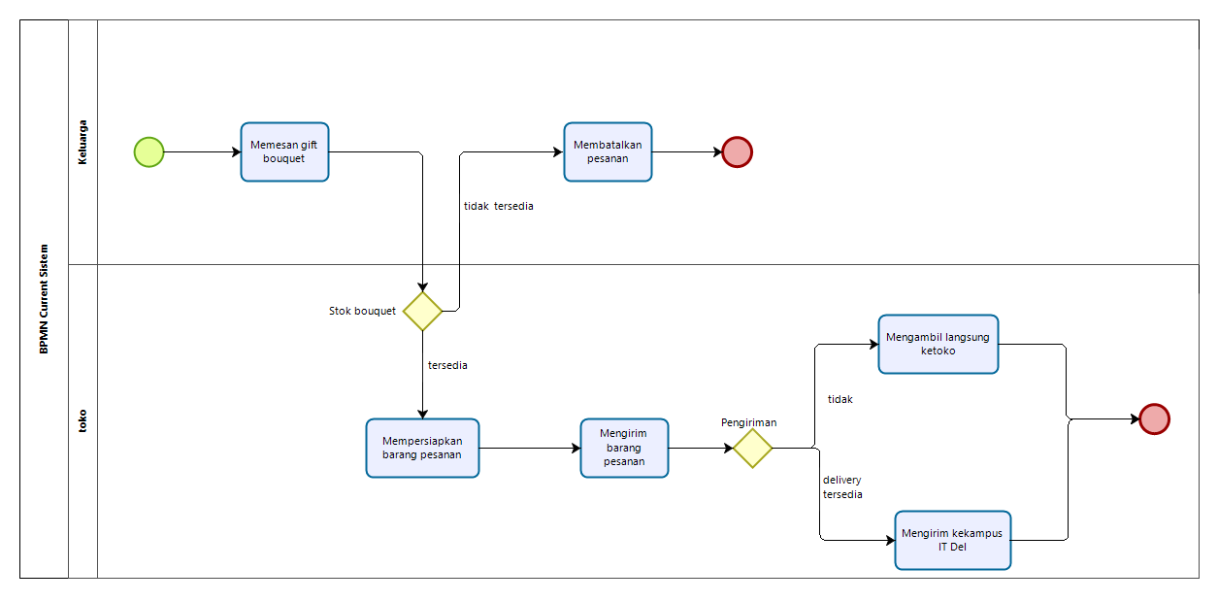
BPMN Current System

Slide 8
Target System
The IT Del gift bouquet information system was created to make it easier for students and their families who are outside the IT Del area to give gift bouquets to students who are inside the IT Del campus. This information system is expected to help and make it easier for students and families outside the IT Del area to give gift bouquets to students who are, for example, taking UTS, UAS or who are working on a final project.

Slide 9
BPMN Target System

Slide 10
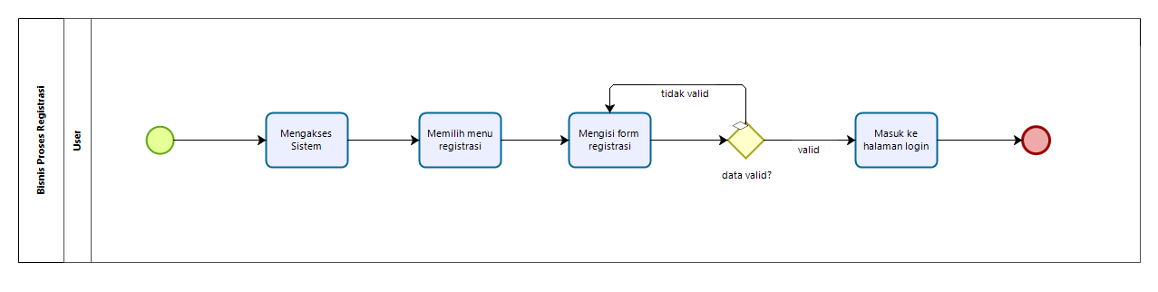
BPMN Reggister Account

Slide 11
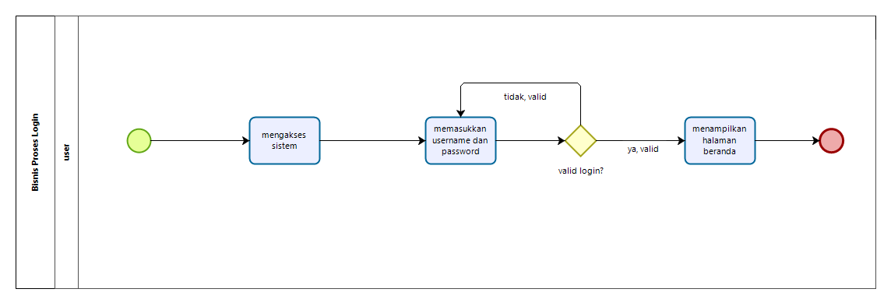
BPMN Login
Business Process Authentication

Slide 12
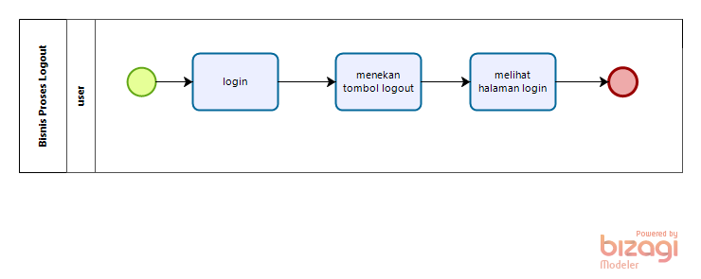
BPMN Logout
Business Process Authentication

Slide 13
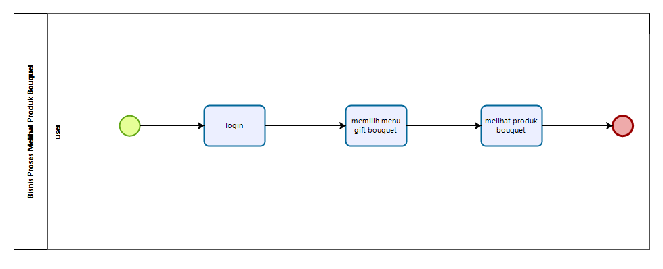
BPMN Viewing Product Bouquet

Slide 14
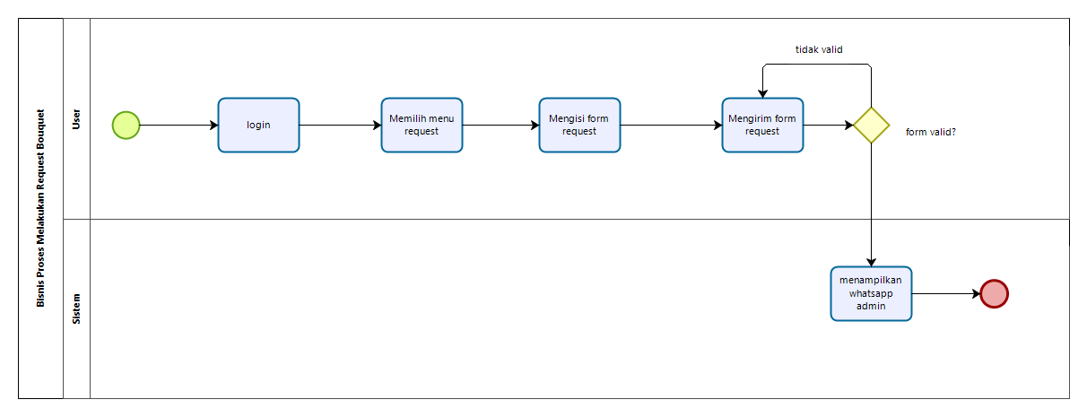
BPMN Making Bouquet Request

Slide 15
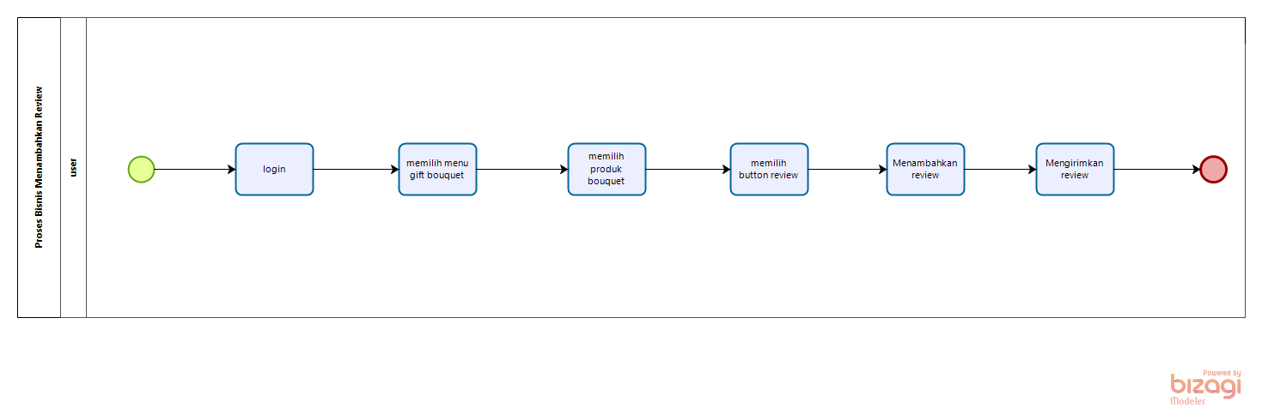
business process managing reviews
BPMN Adding Review

Slide 16
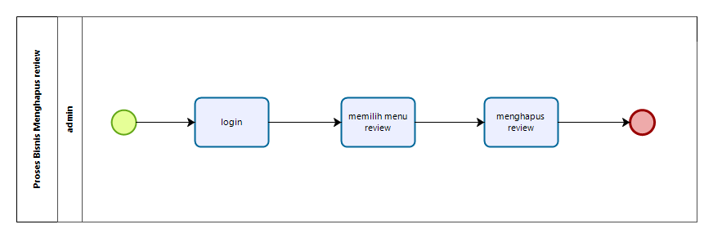
BPMN Deleting Review
business process managing reviews

Slide 17
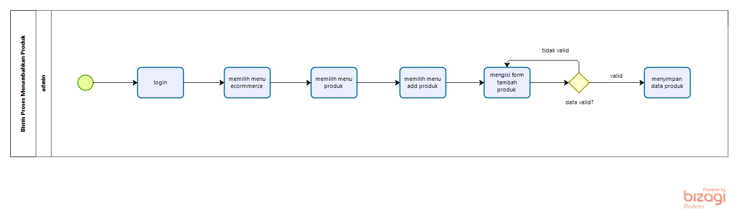
BPMN Adding Product
business process managing products

Slide 18
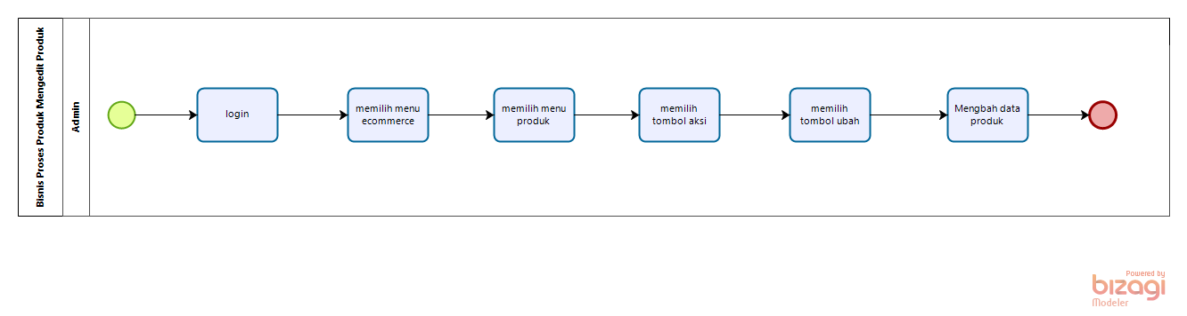
business process managing products
BPMN Editing Product

Slide 19
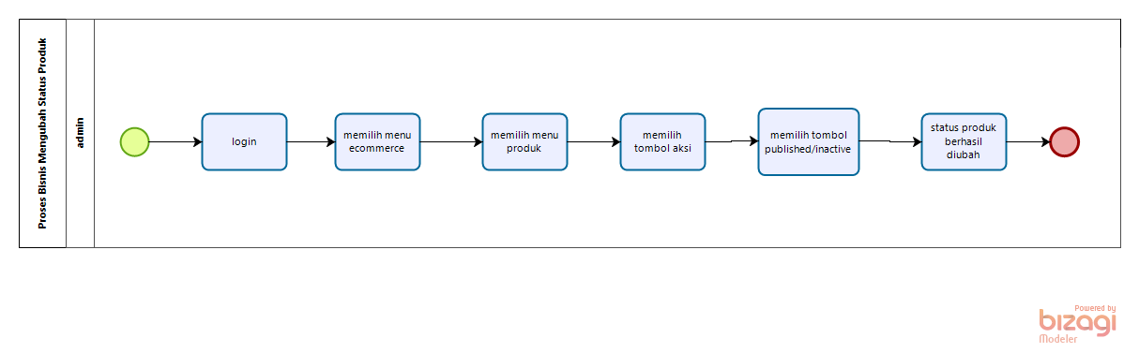
BPMN Changing Product Status
business process managing products

Slide 20
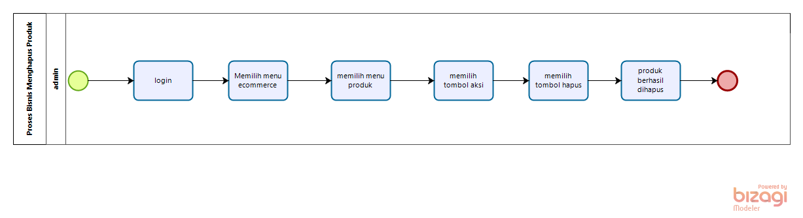
BPMN Deleting Product
business process managing products

Slide 21
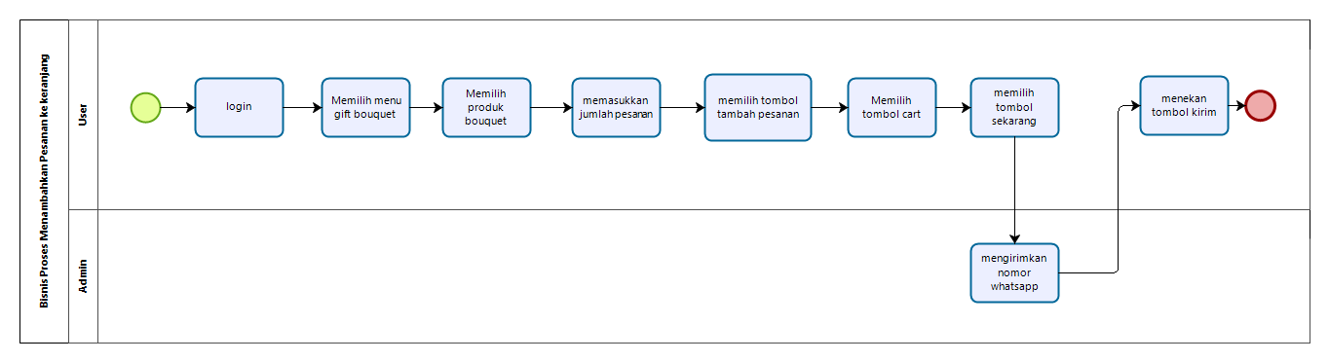
business process of placing an order

Slide 22
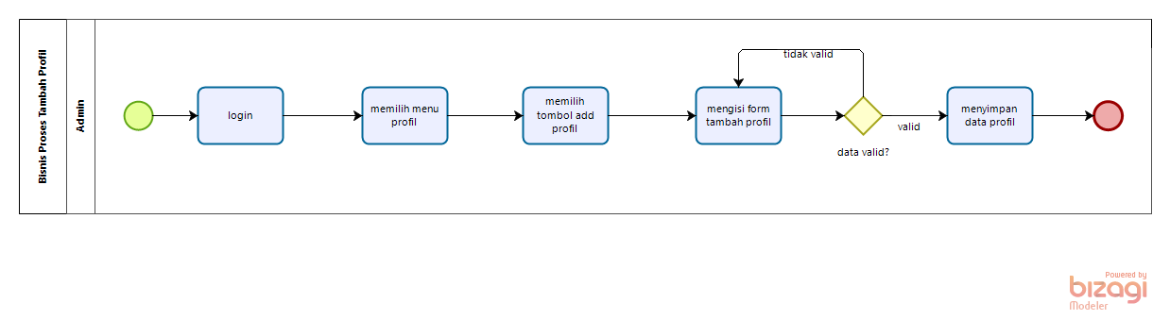
BPMN Adding Profile
Business process of managing profiles

Slide 23
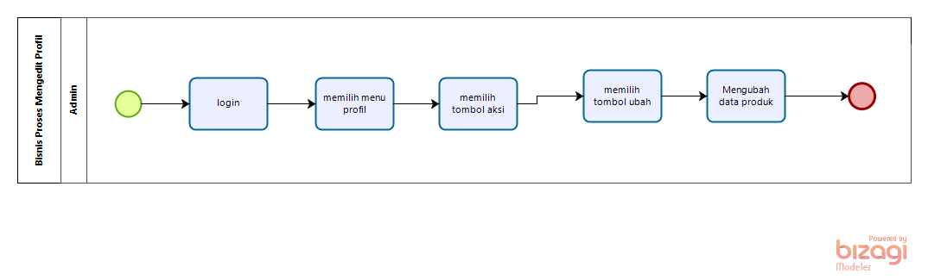
BPMN Editing Profile
Business process of managing profiles
Business process of managing profiles

Slide 24
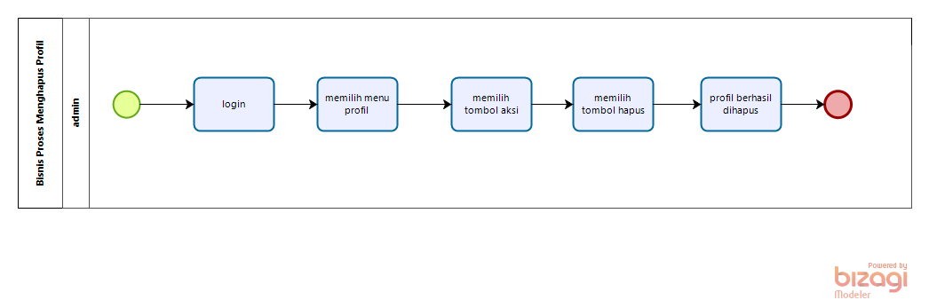
BPMN Deleting Profile
Business process of managing profiles

Slide 25
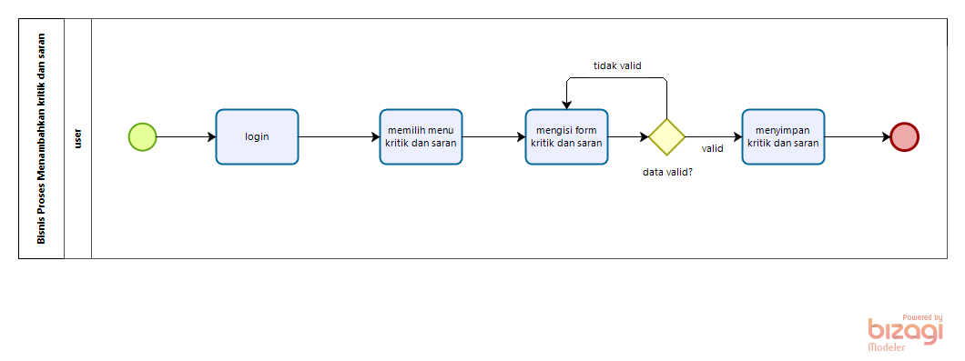
BPMN Adding Critism & Suggestion
business process managing criticism and suggestions

Slide 26
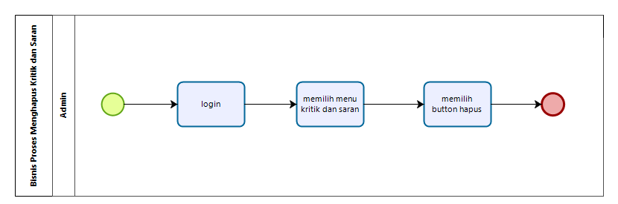
BPMN Deleting Criticism & Suggestion
business process managing criticism and suggestions

Slide 27
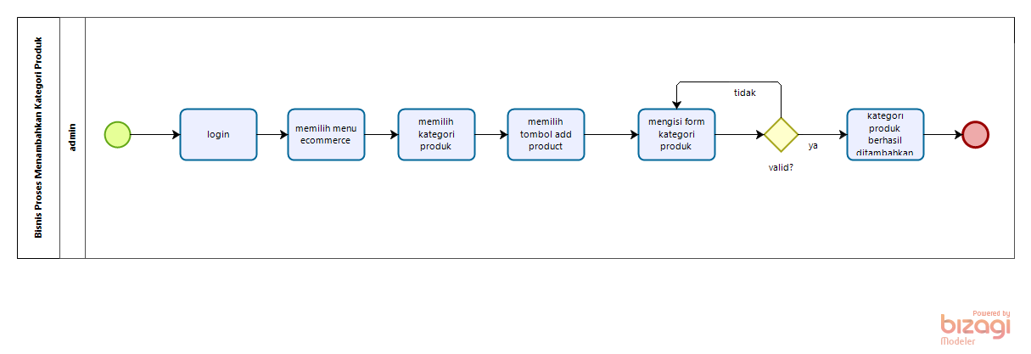
BPMN Adding Product Category
business process of managing product categories

Slide 28
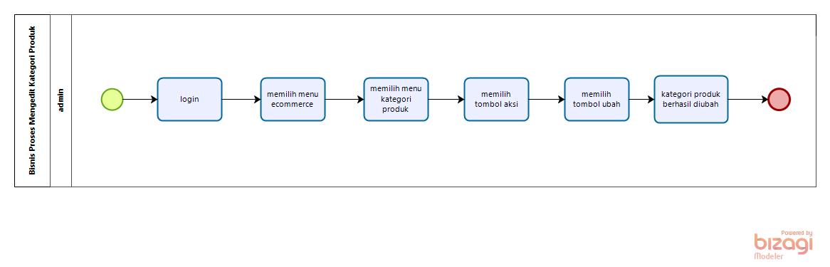
BPMN Editing Product Category
business process of managing product categories

Slide 29
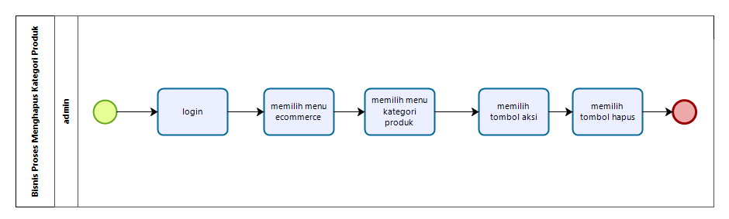
BPMN Deleting Product Category
business process of managing product categories

Slide 30
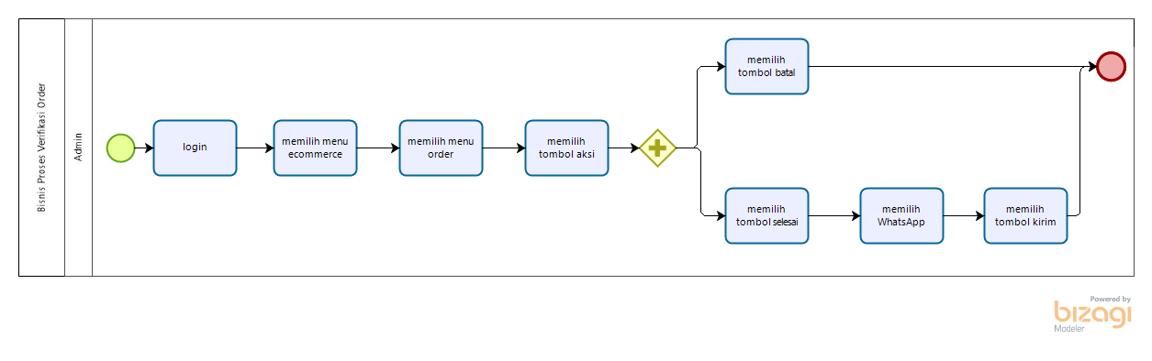
order verification business process

Slide 31
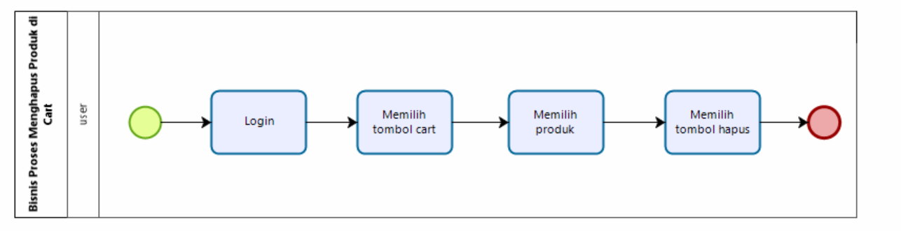
business process of removing products in carts

Slide 32
Usecase Diagram & Usecase Scenario

Slide 33
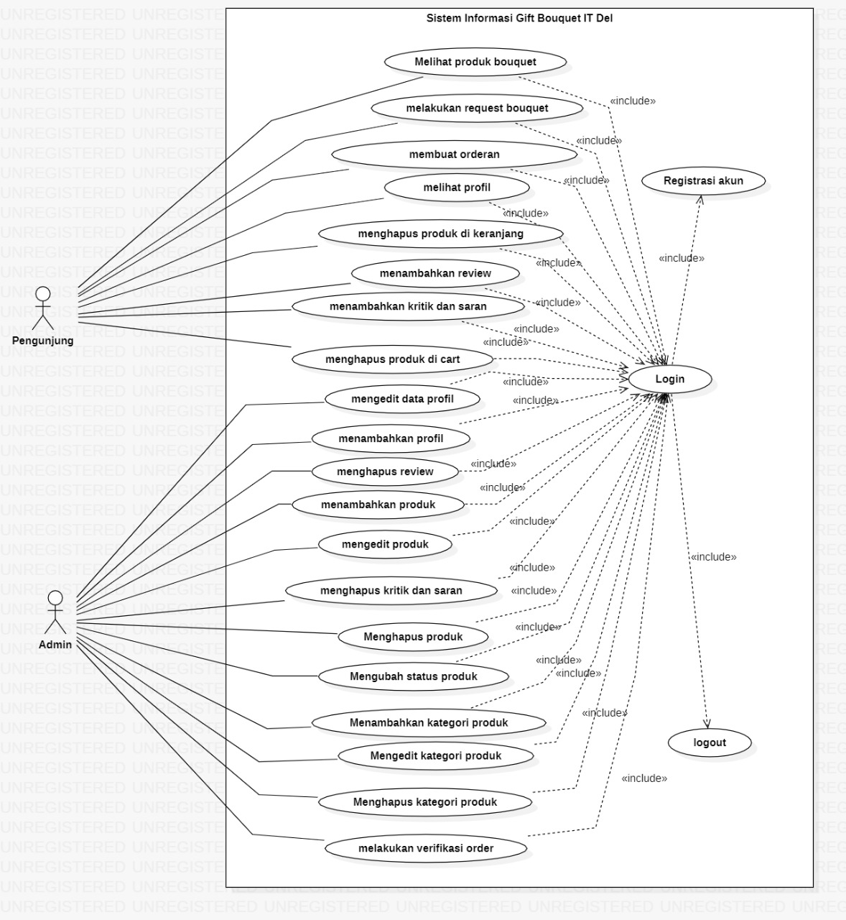
Usecase Diagram

Slide 34
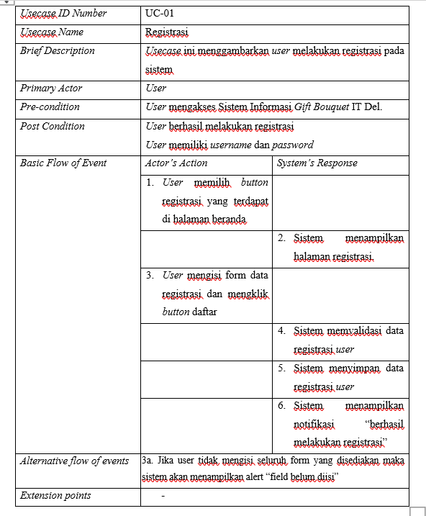
Usecase Scenario Registration

Slide 35
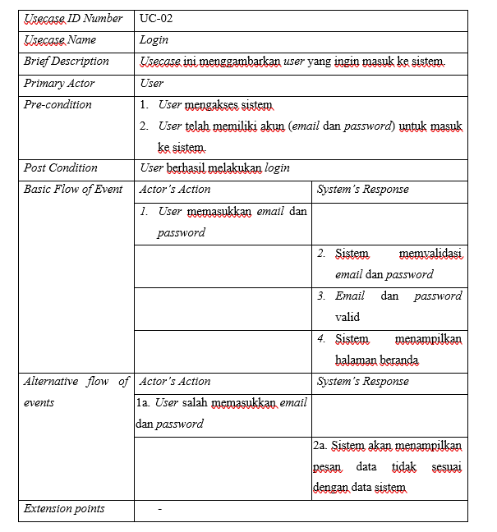
Usecase Scenario
Login

Slide 36
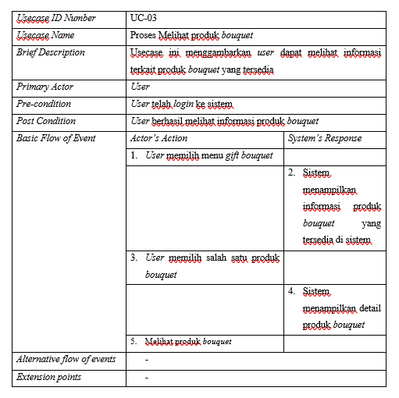
Usecase Scenario process of viewing bouquet

Slide 37
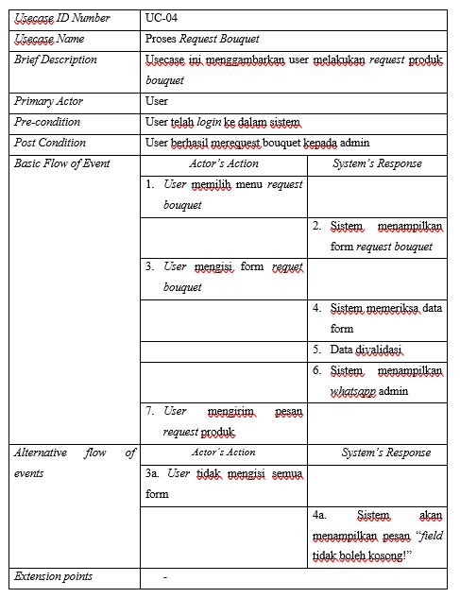
Usecase Scenario process request bouquet

Slide 38
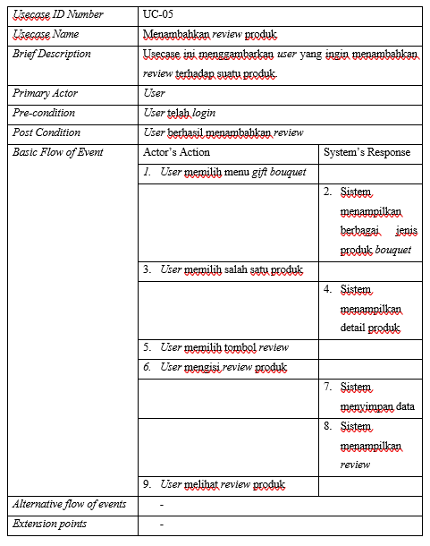
Usecase Scenario adding product review

Slide 39
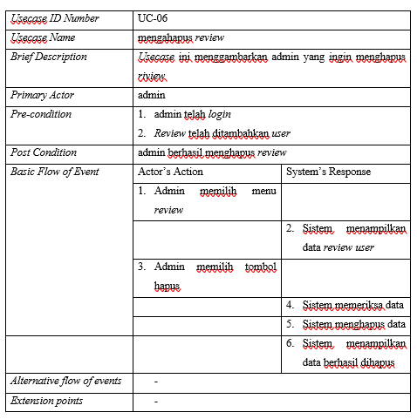
Usecase Scenario
deleting review

Slide 40
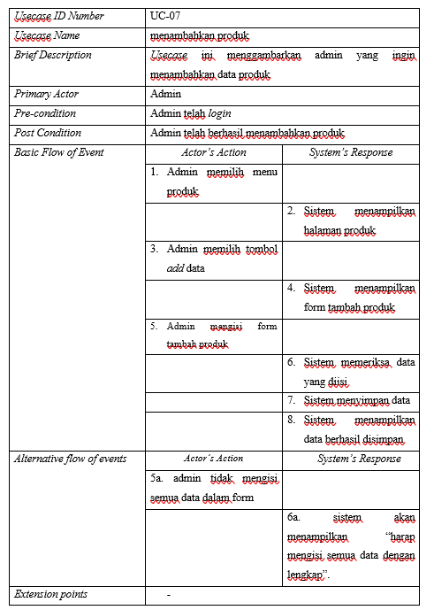
Usecase Scenario
adding product

Slide 41
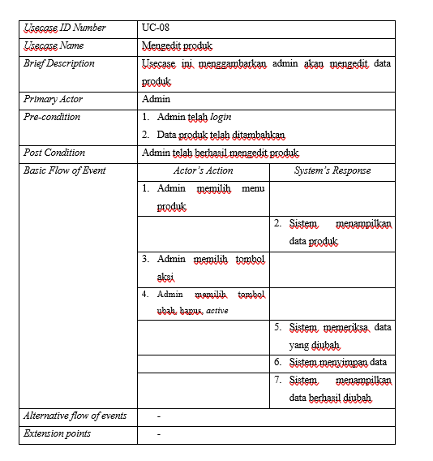
Usecase Scenario
editing product

Slide 42
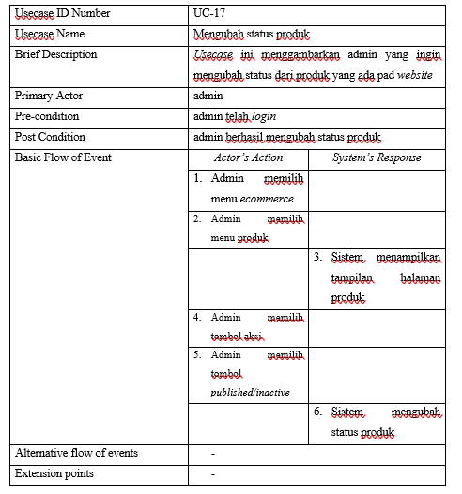
Usecase Scenario
changing product
status

Slide 43
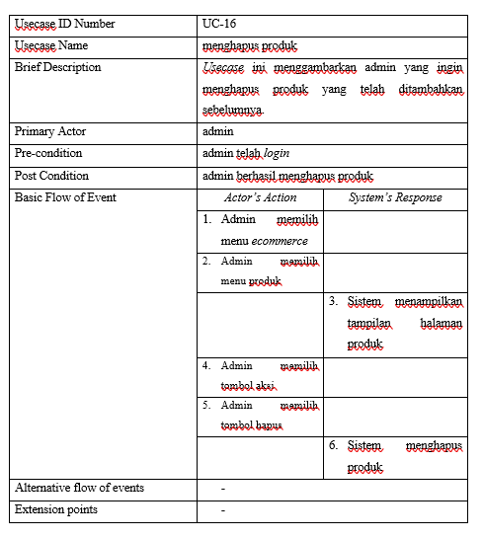
Usecase Scenario
deleting product

Slide 44
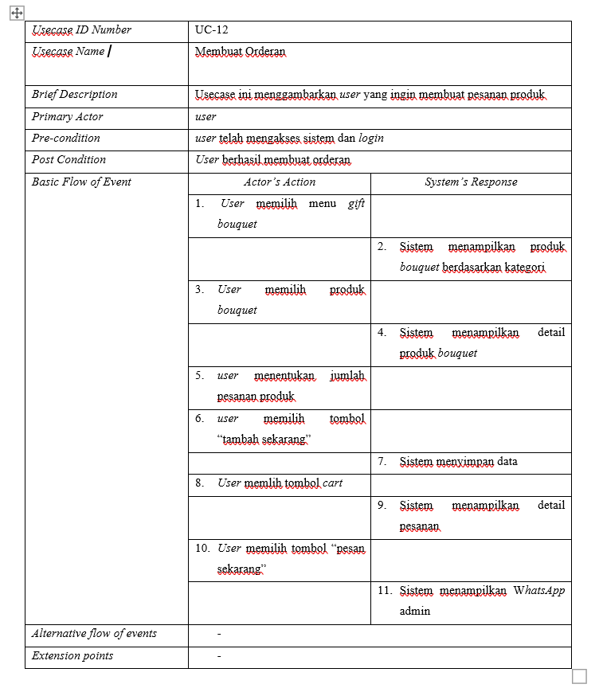
Usecase Scenario of placing an order

Slide 45
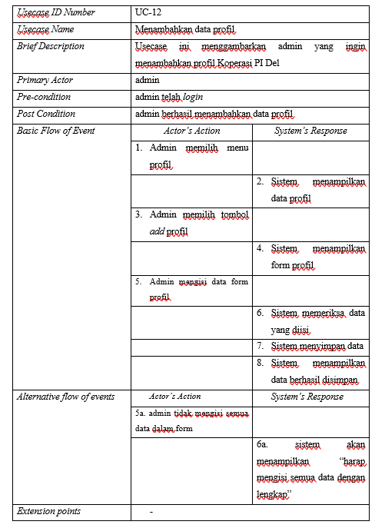
Usecase Scenario
adding profile data

Slide 46
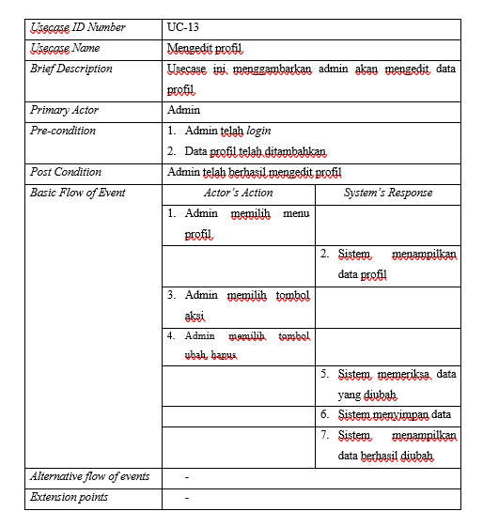
Usecase Scenario
Editing profile data

Slide 47
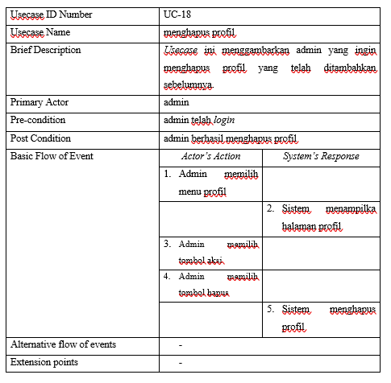
Usecase Scenario
Deleting profile

Slide 48
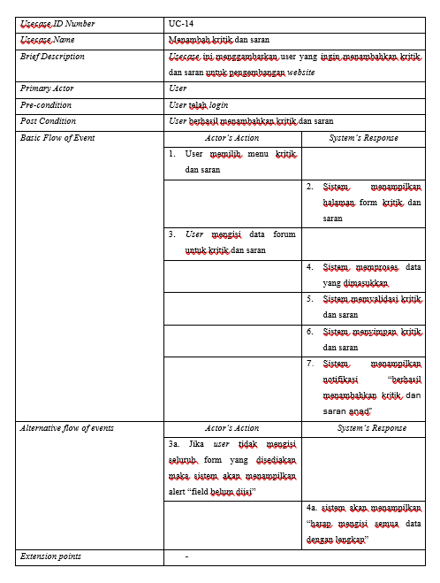
Usecase Scenario
adding criticism and
suggestions

Slide 49
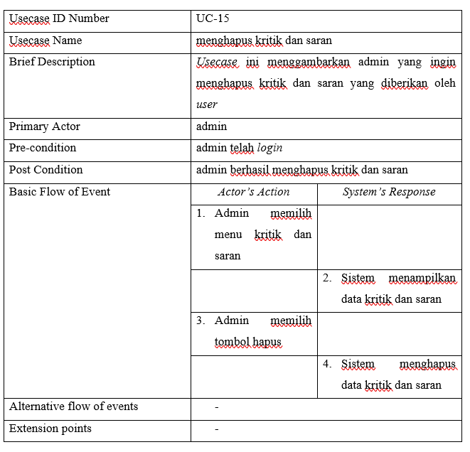
Usecase Scenario
deleting criticism and
suggestions

Slide 50
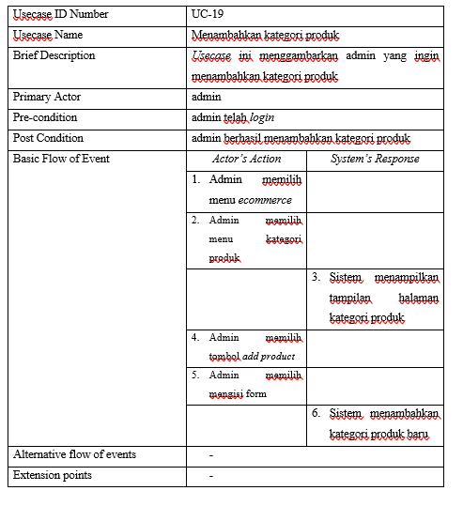
Usecase Scenario
adding product category

Slide 51
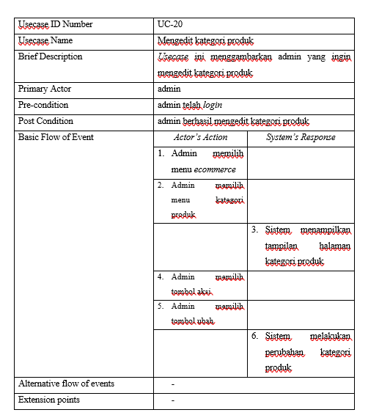
Usecase Scenario
editing product category

Slide 52
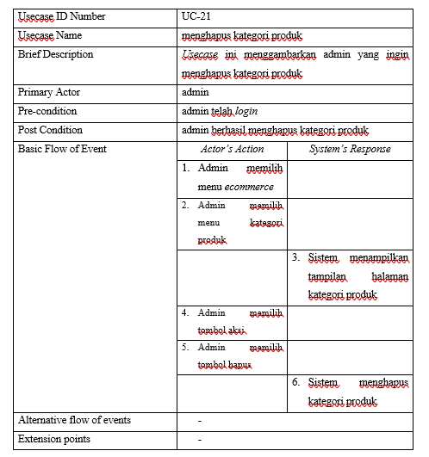
Usecase Scenario
deleting product category

Slide 53
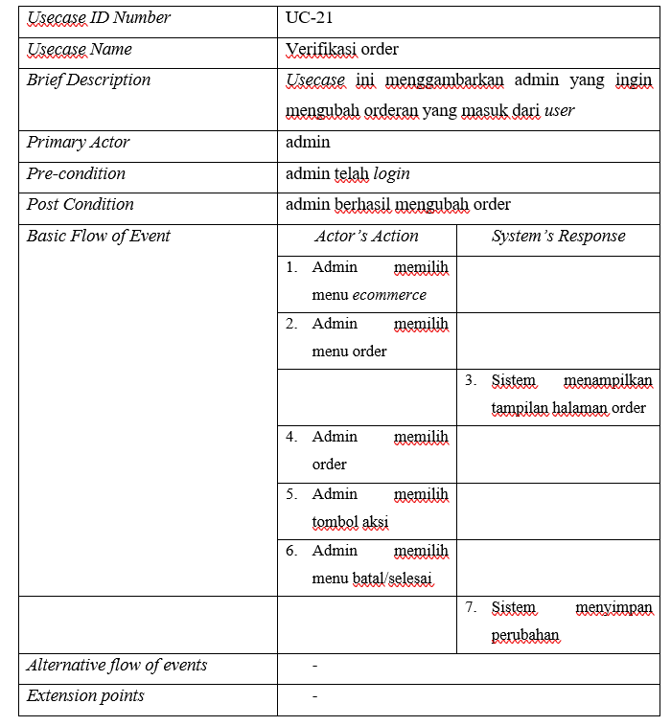
Usecase Scenario Order Verivication

Slide 54
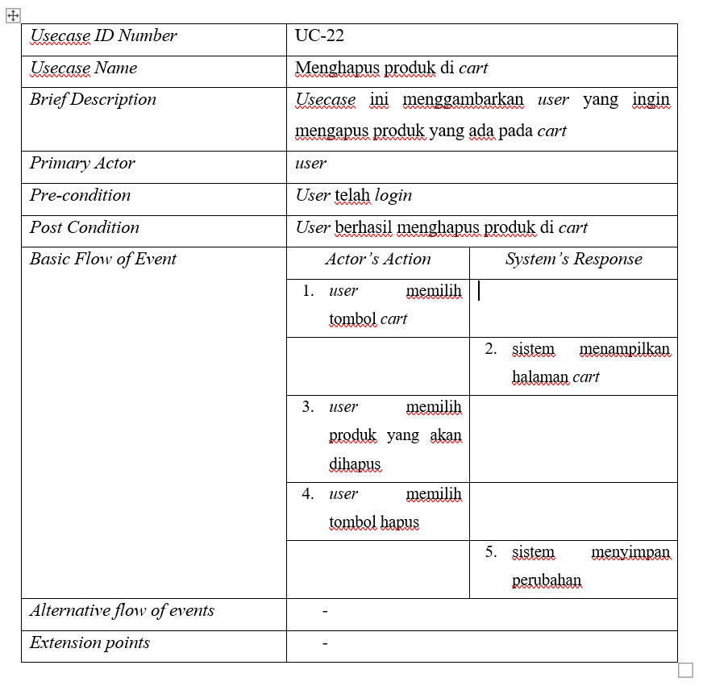
Usecase Scenario Removing Product in Carts

Slide 55
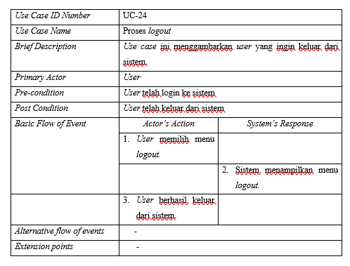
Usecase Scenario
logout

Slide 56
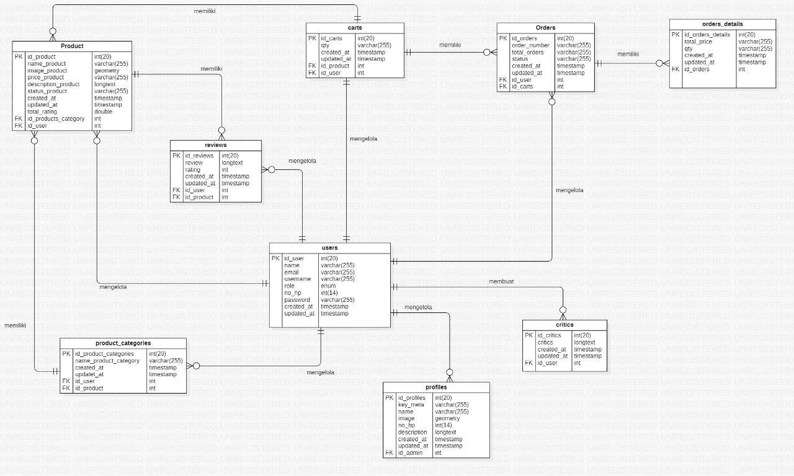
ER-Diagram

Slide 57
Function Reqruitmen
Registration Function
Login Function
Logout Function
Function viewing product
Function making bouquet request
Function of Managing Reviews
Function adding review
Function deleting review
Function Of Managing Products
Function adding product
Function editing product
Function changing product status
Function deleting product
Function of placing an order
Function of Managing Profiles
Function adding profile
Function editing profile
Function deleting profile
Function Of Managing Critis, & Suggestion
Function adding critism & suggestion
Function deleting critism & suggestion
Function Of Managing Product Category
Function adding product category
Function editing product category
Function deleting product category
Function Order Verification
Function Removing Product in Carts

Slide 58
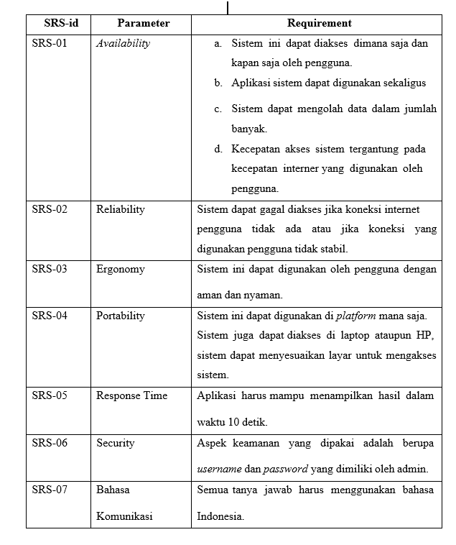
Non-Function Reqruitmen

Slide 59
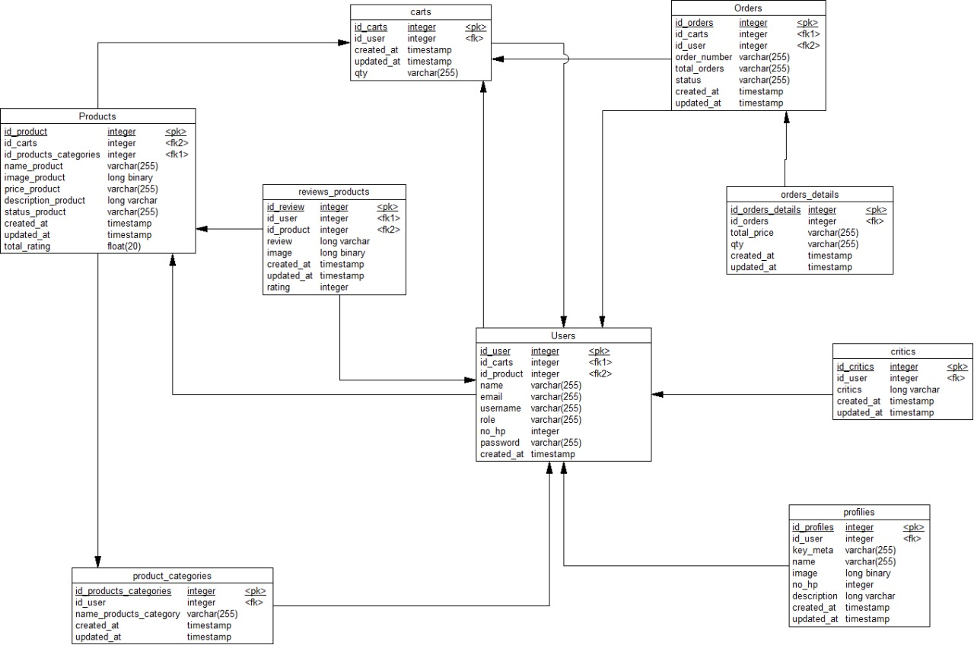
Physical Data Model (PDM)

Slide 60
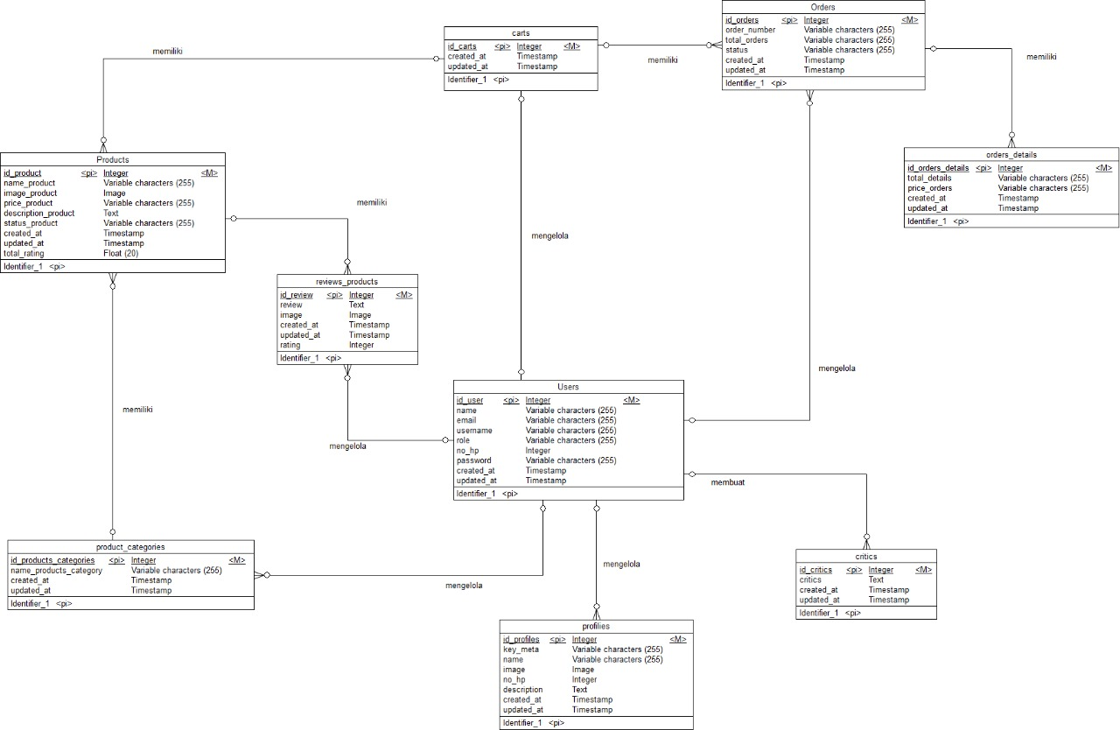
Conceptual Data Model (CDM)

Slide 61

Class Diagram

Slide 62
Sequence Diagram

Slide 63

Sequence diagram Registration

Slide 64

Sequence diagram Login

Slide 65

Sequence diagram Of Viewing Bouquet

Slide 66

Sequence diagram Request
Bouquet

Slide 67

Sequence diagram Adding
Review

Slide 68

Sequence diagram Deleting
Review

Slide 69

Sequence diagram Adding
Product

Slide 70

Sequence diagram Editing
Product

Slide 71

Sequence diagram Changing
Product Status

Slide 72

Sequence diagram Delete
Product

Slide 73

Sequence diagram Of Placing on Order

Slide 74

Sequence diagram Add
Profile

Slide 75

Sequence diagram Edit Profile

Slide 76
Sequence diagram Edit Profile

Slide 77

Sequence diagram Deleting
Profile

Slide 78

Sequence diagram Add
Criticism and Suggestions

Slide 79

Sequence diagram Delete
Criticism and Suggestions

Slide 80

Sequence diagram Add
Product Category

Slide 81

Sequence diagram Edit
Product Category

Slide 82

Sequence diagram Deleting
Product Categories

Slide 83

Sequence diagram Order Verification

Slide 84

Sequence diagram Removing Product in Cart

Slide 85

Sequence diagram Logout

Slide 86
Test Script
&
Result

Slide 87

Test Script & Result
TEST REGISTRATION

Slide 88

Test Script & Result
TEST LOGIN

Slide 89

Test Script & Result
TEST VIEWING PRODUCT BOUQUET

Slide 90

Test Script & Result
TEST REQUEST BOUQUET

Slide 91

Test Script & Result
TEST ADDING
RIVIEW

Slide 92

Test Script & Result
TEST DELETING RIVIEW

Slide 93

Test Script & Result
TEST ADDING
PRODUCT

Slide 94

Test Script & Result
TEST EDITING
PRODUCT

Slide 95

Test Script & Result
TEST CHANGE PRODUCT STATUS

Slide 96

Test Script & Result
TEST DELETING PRODUCT

Slide 97

Test Script & Result
TEST MAKING of PLACING on ORDER

Slide 98

Test Script & Result
TEST ADDING
PROFILE

Slide 99

Test Script & Result
TEST EDITING
PROFILE

Slide 100

Test Script & Result
TEST DELETING
PROFILE

Slide 101

Test Script & Result
TEST ADDING CRITICISM AND SUGGESTIONS

Slide 102

Test Script & Result
TEST DELETING CRITICISM AND SUGGESTIONS

Slide 103

Test Script & Result
TEST ADDING
PRODUCT CATEGORY

Slide 104

Test Script & Result
TEST EDITING
PRODUCT CATEGORY

Slide 105

Test Script & Result
TEST DELETING
PRODUCT CATEGORY

Slide 106

Test Script & Result
TEST ORDER VERIFICATION

Slide 107

Test Script & Result
TEST DELETING
ORDER

Slide 108

Test Script & Result
TEST LOGOUT

Slide 109
Conclusion
IT Del's Gift Bouquet Information System is expected to help customers and the PI Del Cooperative in managing bouquet buying and selling transactions more easily and also for this project to help our group develop knowledge about the application of concepts and materials from various courses that we have studied so far. In the future, it is hoped that the development of this website can be continued to complete the required features

Slide 110
DEMO PRODUCT

Slide 111
Thank You !!!

